Slide 1
Case study

Slide 2
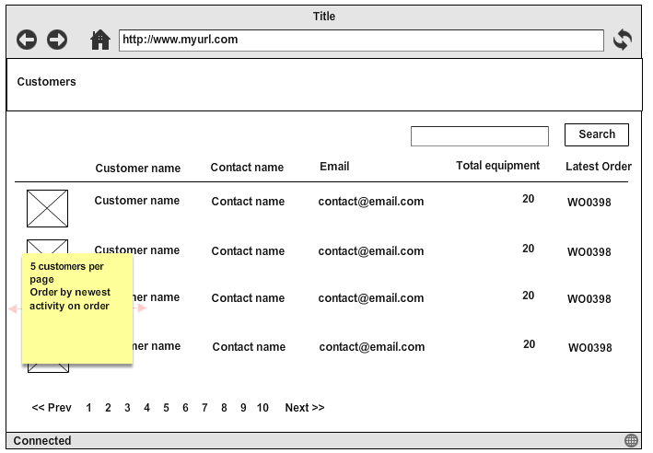
List customers

Slide 3
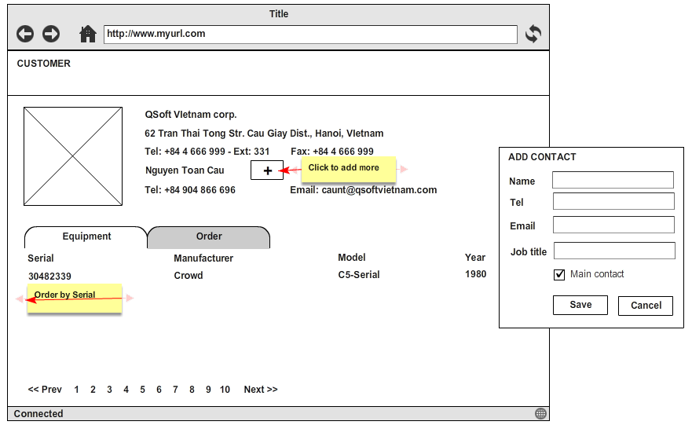
Detail Customer - Equipment

Slide 4
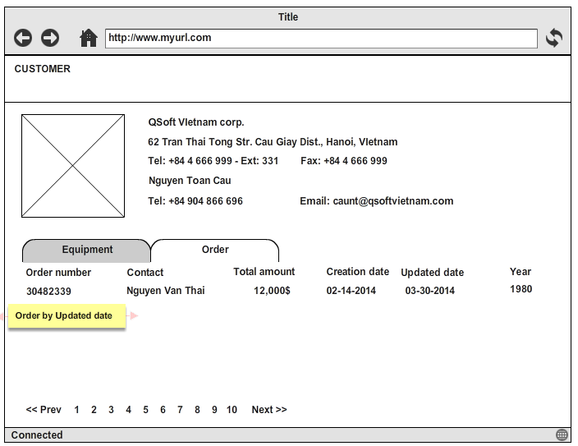
Detail Customer - Order

Slide 5
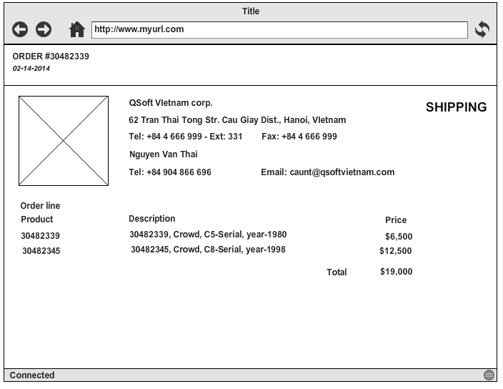
Order Detail

